Slide 1
CHAPTER 10 Graphs
10.1 Graphs and Graph Models
10.2 Graph Terminology and Special Types of Graphs
10.3 Representing Graphs and Graph Isomorphism
10.4 Connectivity
10.5 Euler and Hamilton Paths
10.6 Shortest Path Problems
10.7 Planar Graphs
10.8 Graph Coloring

Slide 2
10.3 Representing Graphs and Graph Isomorphism
1. Representing Graphs
Methods for representing graphs:
  Graphs
  Adjacency lists
  -- lists that specify all the vertices that are adjacent to each vertex
  Adjacency matrices
  Incidence matrices
An adjacency list for a directed graph
Initial vertex | terminal vertices
a b c d e | b,c,d,e b,d a,c,e b,c,d
An adjacency list for a simple graph
vertex | Adjacent vertices
a b c d e | b,c,e a a,d,e c,e a,c,d

Slide 3

10.3 Representing Graphs and Graph Isomorphism
2. Adjacency Matrices
A simple graph G = (V, E) with n vertices ( ) can be represented by its adjacency matrix, A, with respect to this listing of the vertices, where
a_{ij} = 1 if {v_{i}, v_{j}} is an edge of G,
a_{ij} = 0 otherwise.
Note: An adjacency matrix of a graph is based on the ordering chosen for the vertices.

Slide 4
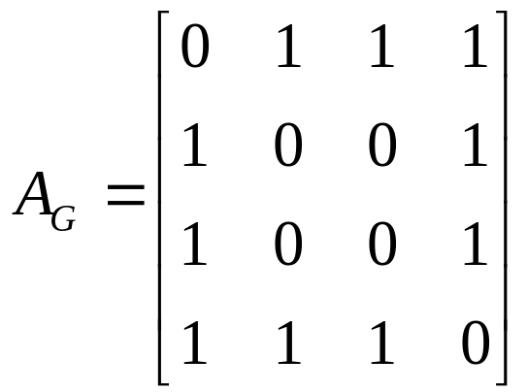
10.3 Representing Graphs and Graph Isomorphism
Note: Adjacency matrices of undirected graphs are always symmetric.
〖Example 1〗 What is the adjacency matrix A_{G} for the following graph G based on the order of vertices a, b, c, d ?
a
Solution:
b
d
c

Slide 5
10.3 Representing Graphs and Graph Isomorphism
  The adjacency matrix of a multigraph or pseudograph
For the representation of graphs with multiple edges, we can no longer use zero-one matrices.
Instead, we use matrices of nonnegative integers.
The (i, j)th entry of such a matrix equals the number of edges that are associated to {v_{i}, v_{j}}.

Slide 6
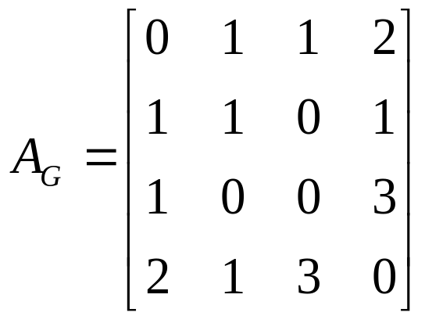
10.3 Representing Graphs and Graph Isomorphism
〖Example 2〗 What is the adjacency matrix A_{G} for the following graph G based on the order of vertices a, b, c, d ?
a
Note: For undirected multigraph or pseudograph , adjacency matrices are symmetric.
b
d
c
Solution:

Slide 7
10.3 Representing Graphs and Graph Isomorphism
  The adjacency matrix of a directed graph
Let G = (V, E) be a directed graph with |V| = n. Suppose that the vertices of G are listed in an arbitrary order as v₁, v₂, …, v_{n}.
The adjacency matrix A (or A_{G}) of G, with respect to this listing of the vertices, is the n×n zero-one matrix with 1 as its (i, j)th entry when there is an edge from v_{i} to v_{j}, and 0 otherwise.
In other words, for an adjacency matrix A = [a_{ij}],
a_{ij} = 1 if (v_{i}, v_{j}) is an edge of G,
a_{ij} = 0 otherwise.

Slide 8
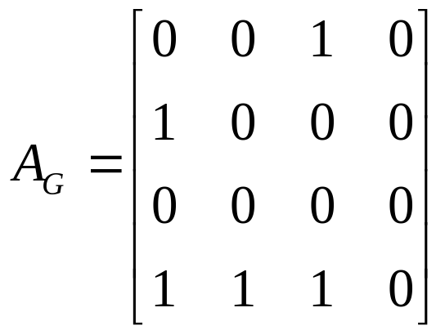
10.3 Representing Graphs and Graph Isomorphism
〖Example 3〗 What is the adjacency matrix A_{G} for the following graph G based on the order of vertices a, b, c, d ?
a
b
d
c
Solution:

Slide 9
10.3 Representing Graphs and Graph Isomorphism
Question:
What is the sum of the entries in a row of the adjacency matrix for an undirected graph?
a
b
d
c

Slide 10
10.3 Representing Graphs and Graph Isomorphism
Question:
What is the sum of the entries in a row of the adjacency matrix for an undirected graph?
The number of edges incident to the vertex i, which is the same as degree of i minus the number of loops at i.
For a directed graph?
a
b
d
c

Slide 11
10.3 Representing Graphs and Graph Isomorphism
Question:
What is the sum of the entries in a row of the adjacency matrix for an undirected graph?
The number of edges incident to the vertex i, which is the same as degree of i minus the number of loops at i.
For a directed graph?
deg⁺(v_{i})
What is the sum of the entries in a column of the adjacency matrix for an undirected graph?
The number of edges incident to the vertex i, which is the same as degree of i minus the number of loops at i.
For a directed graph?
deg⁻(v_{i})

Slide 12


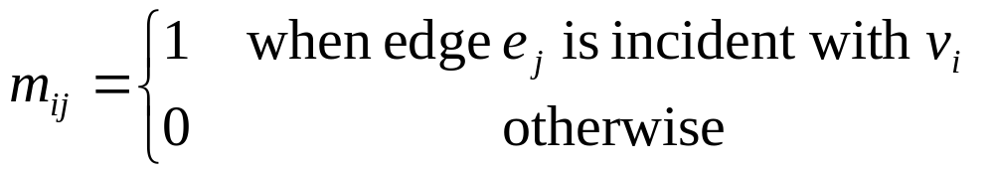
10.3 Representing Graphs and Graph Isomorphism
3. Incidence matrices
Let G = (V, E) be an undirected graph. Suppose that
are the vertices and are the edges of G. Then the incidence matrix with respect to this ordering of V and E is n×m matrix , where

Slide 13
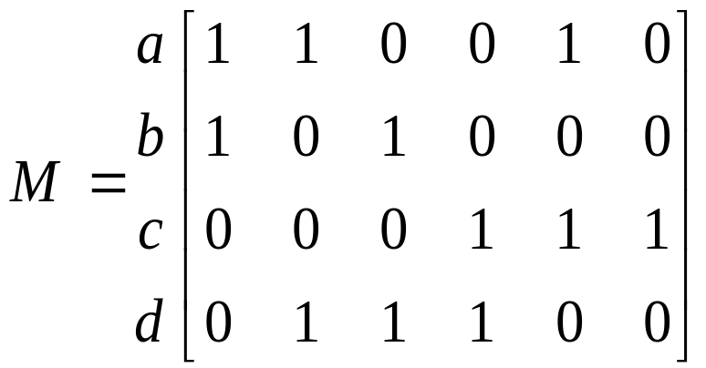
9.3 Representing Graphs and Graph Isomorphism
〖Example 4〗 What is the incidence matrix M for the following graph G based on the order of vertices a, b, c, d and edges 1, 2, 3, 4, 5, 6?
a
1
2
b
d
3
5
4
c
Solution:
6
Note:
Incidence matrices of undirected graphs contain two 1s per column for edges connecting two distinct vertices and one 1 per column for loops.

Slide 14
10.3 Representing Graphs and Graph Isomorphism
4. Isomorphism of Graphs
Graphs with the same structure are said to be isomorphic.
Formally, two simple graphs G₁= (V₁, E₁) and G₂= (V₂, E₂) are isomorphic if there is a 1-1 and onto function f from V₁ to V₂ such that for all a and b in V₁, a and b are adjacent in G₁ iff f(a) and f(b) are adjacent in G₂.
Such a function f is called an isomorphism.
In other words, when two simple graphs are isomorphic, there is a one-to-one correspondence between vertices of the two graphs that preserves the adjacency relationship.

Slide 15
10.3 Representing Graphs and Graph Isomorphism
For example,
a
a' (b)
b
d‘(d)
d
c
c' (a)
b' (c)

Slide 16
10.3 Representing Graphs and Graph Isomorphism
Question:
How to determine whether two simple graphs are isomorphic?
It is usually difficult since there are n! possible 1-1 correspondence between the two vertex sets with n vertices. However, some properties (called invariants) in the graphs may be used to show that they are not isomorphic.
invariants
-- things that G₁ and G₂ must have in common to be isomorphic.

Slide 17
10.3 Representing Graphs and Graph Isomorphism
Important invariants in isomorphic graphs:
  the number of vertices
  the number of edges
  the degrees of corresponding vertices
  if one is bipartite, the other must be
  if one is complete, the other must be
  if one is a wheel, the other must be
  etc.

Slide 18
10.3 Representing Graphs and Graph Isomorphism
〖Example 5〗 Are the following two graphs isomorphic?
a
a
b
e
e
b
c
d
c
d
Solution:
They are isomorphic, because they can be arranged to look identical.
You can see this if in the right graph you move vertex b to the left of the edge {a, c}. Then the isomorphism f from the left to the right graph is:
f(a) = e, f(b) = a,
f(c) = b, f(d) = c, f(e) = d.

Slide 19
10.3 Representing Graphs and Graph Isomorphism
〖Example 6〗 Show that the following two graphs are isomorphic.
u₁
u₂
v₁
v₂
u₅
v₅
v₃
u₃
v₄
u₄
Proof:
Try to find an 1-1 and onto function f
Show that f isomorphism (preserves adjacency relation)
- The adjacency matrix of a graph G is the same as the adjacency matrix of another graph H, when rows and columns are labeled to correspond to the images under f of the vertices in G that are the labels of these rows and columns in the M_{G}

Slide 20
10.3 Representing Graphs and Graph Isomorphism
〖Example 7〗 Determine whether the given pair of graphs is isomorphic?
(1)
(2)
(3)

Slide 21
CHAPTER 10 Graphs
10.1 Graphs and Graph Models
10.2 Graph Terminology and Special Types of Graphs
10.3 Representing Graphs and Graph Isomorphism
10.4 Connectivity
10.5 Euler and Hamilton Paths
10.6 Shortest Path Problems
10.7 Planar Graphs
10.8 Graph Coloring

Slide 22
10.4 Connectivity
1. Paths
A path of length n in a simple graph is a sequence of vertices v₀, v₁, . . . , v_{n} such that {v₀, v₁} , {v₁, v₂} , ..., {v _{n-1}, v_{n}} are n edges in the graph.
The path is a circuit if it begins and ends at the same vertex (length greater than 0).
A path is simple if it does not contain the same edge more than once.

Slide 23
10.4 Connectivity
Note:
There is nothing to prevent traversing an edge back and forth to produce arbitrarily long paths. This is usually not interesting which is why we define a simple path.
The notation of a path: vertex sequence
A path of length zero consists of a single vertex.

Slide 24
10.4 Connectivity
Path in directed graph
A path of length n in a directed graph is a sequence of vertices v₀, v₁, . . . v_{n} such that (v₀, v₁) , (v₁, v₂) , ..., (v_{n-1}, v_{n}) are n directed edges in the graph.
Circuit or cycle : the path begins and ends with the same vertex.
Simple path: the path does not contain the same edge more than once.

Slide 25
10.4 Connectivity
Paths represent useful information in many graph models.
〖Example 1〗Path in Acquaintanceship Graphs
In an acquaintanceship graph there is a path between two people if there is a chain of people linking these people, where two people adjacent in the chain know one other.
Many social scientists have conjectured that almost every pair of people in the world are linked by a small chain of people, perhaps containing just five or fewer people.
The play Six Degrees of Separation by John Guare is based on this notion.

Slide 26
9.4 Connectivity
2. Counting paths between vertices
The number of paths between two vertices in a graph can be determined using its adjacency matrix.

Slide 27




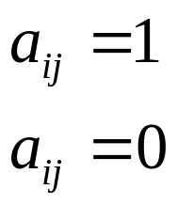
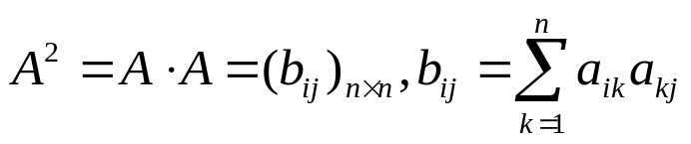

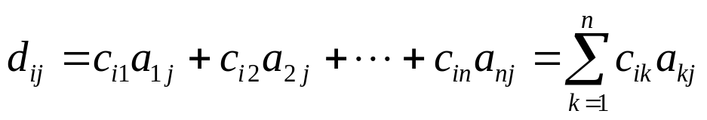
9.4 Connectivity
【 Theorem 2】 The number of different paths of length r from
v_{i} to v_{j} is equal to the (i, j)th entry of A^{r}, where A is the
adjacency matrix representing the graph consisting of vertices
v₁, v₂, . . . v_{n}.
Note: This is the standard power of A, not the Boolean product.
Proof:
Let
(3)
b_{ij}: the number of different paths of length 2
from v_{i} to v_{j}

Slide 28
10.4 Connectivity
v₄
〖Example 2〗
v₁
v₂
v₅
v₆
v₃
How many paths of length 2 are there from v₅ to v₄?
a₅₄ in A²: 1
(2) The number of paths not exceeding 6 are there from v₄ to v₅?
a₄₅ in A+A²+A³+A⁴+A⁵+A⁶ : 2
(3) The number of circuits starting at vertex v₅ whose length is not exceeding 6?

Slide 29
10.4 Connectivity
3. Connectedness in undirected graphs
An undirected graph is called connected if there is a path between every pair of distinct vertices of the graph.
〖Example 3〗 Are the following graphs connected?
a
b
a
b
e
e
d
d
c
c
No.
Yes.

Slide 30
10.4 Connectivity
【 Theorem 1】 There is a simple path between every pair of
distinct vertices of a connected undirected graph.
Proof:
Because the graph is connected there is a path between u and v. Throw out all redundant circuits to make the path simple.

Slide 31
10.4 Connectivity
The maximally connected subgraphs of G are called the connected components or just the components.
For example,
i
h
d
a
e
g
b
c
f
j

Slide 32
10.4 Connectivity
A vertex is a cut vertex (or articulation point), if removing it and all edges incident with it results in more connected components than in the original graph.
Similarly if removal of an edge creates more components the edge is called a cut edge or bridge.
For example,
（1）
In the star network the center vertex is a cut vertex.
All edges are cut edges.

Slide 33
10.4 Connectivity
（2）
There are no cut edges or vertices in the graph G above.
Removal of any vertex or edge does not create additional components.

Slide 34
10.4 Connectivity
4. Connectedness in directed graphs
A directed graph is strongly connected if there is a path from a to b and from b to a for all vertices a and b in the graph.
The graph is weakly connected if the underlying undirected graph is connected.
Note: By the definition, any strongly connected directed graph is also weakly connected.

Slide 35
10.4 Connectivity
For example,
a
a
b
b
d
d
c
c
Weakly connected
Strongly connected

Slide 36
10.4 Connectivity
For directed graph, the maximal strongly connected subgraphs are called the strongly connected components or just the strong components.
For example,
a
b
c
e
d
Problems:
How to determine whether a given directed graph is strongly connected or weakly connected ?
How to find the strongly connected components in a directed graph ?

Slide 37
10.4 Connectivity
5. Paths and Isomorphism
Idea:
Some other invariants
  The number and size of connected components
  Path
  Two graphs are isomorphic only if they have simple circuits of the same length.
  Two graphs are isomorphic only if they contain paths that go through vertices so that the corresponding vertices in the two graphs have the same degree.
We can also use paths to find mapping that are potential isomorphism.

Slide 38
10.4 Connectivity
〖Example 4〗 Are these two graphs isomorphic?
Solution:
No.
Because the right graph contains circuits of length 3, while the left graph does not.

Slide 39
Homework: (No need to submit)
Ver. 8
Sec. 10.3 8, 15, 17, 38-41
Sec. 10.4 27(e), 28, 29, 62
Ver. 7
Sec. 10.3 8, 15, 17, 34-37
Sec. 10.4 27(e), 28, 29, 62

